Slide 1
Highway Materials Lecture - 15
Designed and presented
By
Asst. Prof. Dr. Raquim Nihad Zehawi

Slide 2
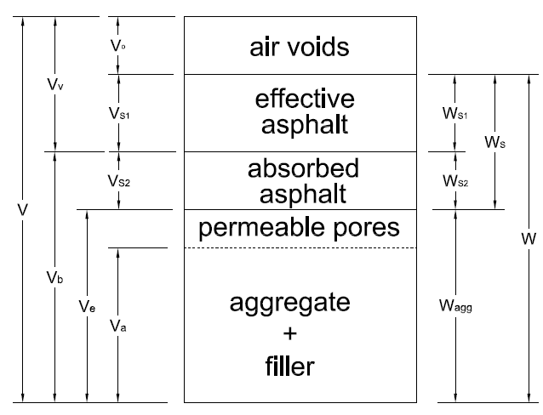
Vo : volume of air voids in total mix
VS1 : volume of effective asphalt
VS2 : volume of absorbed asphalt
Va : apparent volume of aggregate
Ve : effective volume of aggregate
Vb : bulk volume of aggregate
Vv : voids in mineral aggregate
V : total volume of mixture
% AV : percentage of air voids in total mix
$\%AV=\frac{V_{o}}{V_{m}}×100$
% VMA : percentage of voids in mineral aggregate
$\%VMA=\frac{V_{o}+V_{S1}}{V_{m}}×100$
% VFA : percentage of voids filled with asphalt
$\%VFA=\frac{V_{S1}}{V_{o}+V_{S1}}×100$

Slide 3
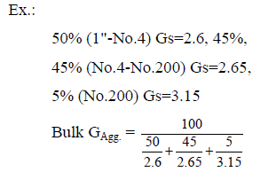
Bulk GA = bulk specific gravity of combined aggregate $=\frac{W_{Agg}}{V_{b}}$
$$=\frac{100}{\frac{\% cource}{G_{s(cource)}}+\frac{\% fine}{G_{s(fine)}}+\frac{\% filler}{G_{s(filler)}}}$$
= 2.64

Slide 4
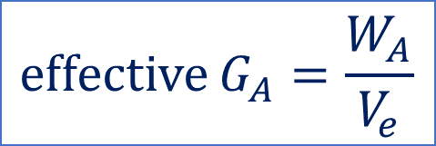
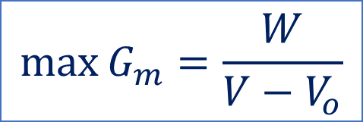
Ps = total percentage of asphalt (by weight of the total mix)
PA = percentage of aggregate (by weight of the total mix)
Ps + PA = 100%
PA = 100 - Ps
Theoretically in void-less mix
the maximum specific gravity of the mixture (max Gm)
the (max Gm) by testing in the lab. According to (ASTM, D2041)
$$\max{G_{m}=\frac{W}{V−V_{o}}}$$
$$\operatorname{effective}{G_{A}=\frac{W_{A}}{V_{e}}}$$
the bulk or actual specific gravity of the mixture (Bulk Gm)
$$\operatorname{Bulk}{G_{m}=\frac{W}{V}}=\frac{W_{in air}}{{W_{in air}−W}_{in water}}$$
This bulk specific gravity (Bulk Gm) is either taken from a core specimen of an existing pavement or a sample compacted in lab

Slide 5
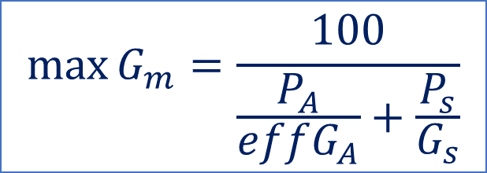
For loos uncompact mixture at nearly optimum asphalt content
$$\operatorname{effective}{G_{A}=\frac{100−P_{s}}{\frac{100}{maxG_{m}}−\frac{P_{s}}{G_{s}}}}$$
Since effective GA is a constant property (independent of asphalt content)
by conducting a lab test to determine the theoretical max Gm for a certain Ps, the effective GA could be found and then this equation could be used to determine the max Gm for any other Ps other than optimum without lab test.
For any other asphalt content
$$\max{G_{m}=\frac{100}{\frac{P_{A}}{effG_{A}}+\frac{P_{s}}{G_{s}}}}$$
$$\max{G_{m}=\frac{100}{\frac{100−P_{s}}{effG_{A}}+\frac{P_{s}}{G_{s}}}}$$
or
Note: $\frac{P_{s}}{G_{s}}$ may represent the asphalt volume in the mix and $\frac{P_{A}}{{eff G}_{A}}$ is the effective volume of aggregate

Slide 6
$\%AV=\frac{V_{o}}{V_{m}}×100$
$\%AV=\frac{{\max{G}}_{m}−{Bulk G}_{m}}{{\max{G}}_{m}}×100$
$\%AV=\left(1−\frac{{Bulk G}_{m}}{{\max{G}}_{m}}\right)×100$
Or it can be derived as:
$\%AV=\frac{V_{o}}{V_{m}}=\frac{V_{o}+V_{m}−V_{m}}{V_{m}}=\frac{V_{m}−(V_{m}−V_{o})}{V_{m}}=1−\frac{V_{m}−V_{o}}{V_{m}}=0$
$$=1−\frac{\left(V_{m}−V_{o}\right).w_{m}}{V_{m}.w_{m}}=1−\frac{\frac{w_{m}}{V_{m}}}{\frac{w_{m}}{V_{m}−V_{o}}}=1−\frac{{Bulk G}_{m}}{{\max{G}}_{m}}$$
Air voids should range between ( 3 – 5)

Slide 7
$\%VMA=\frac{V_{V}}{V_{m}}×100$
$=100−\frac{{Bulk G}_{m}×P_{A}}{{\operatorname{Bulk}{G}}_{A}}$
can be derived as follows:
$\%VMA=\frac{V_{V}}{V_{m}}=\frac{V_{m}−V_{b}}{V_{m}}=1−\frac{V_{b}}{V_{m}}=1−\frac{V_{b}.w_{m}}{V_{m}.w_{m}}=1−\frac{Bulk G_{m}.V_{b}}{w_{m}}.\frac{w_{A}}{w_{A}}$
$=1−\frac{Bulk G_{m}.\frac{P_{A}}{100} }{Bulk G_{A}}=100−\frac{{Bulk G}_{m}.P_{A}}{{Bulk G}_{A}}$
Minimum V.M.A = 15

Slide 8
$\%VFA=\frac{V_{S1}}{V_{V}}×100$
$\%VFA=\frac{VMA−AV}{VMA}×100$
can be derived as follows:
$$\%VFA=\frac{V_{S1}}{V_{V}}=\frac{V_{V}−V_{o}}{V_{V}}=\frac{{(V}_{V}−V_{o})/V_{m}}{V_{V}/V_{m}}=\frac{VMA−AV}{VMA}$$
$\%VFA=\frac{{Bulk G}_{m}×P_{S1}}{{\operatorname{Bulk}{G}}_{m}×P_{S1}+G_{S}×\%AV}×100$
Voids filled asphalt should range between ( 70 – 85)

Slide 9
The absorbed asphalt (by weight of aggregate)
$absorbed asphalt {P"}_{S2}^{}=\frac{V_{S2}.G_{S}}{w_{A}}=\left[\frac{1}{{Bulk G}_{A}}−\frac{1}{{eff G}_{A}}\right].G_{s}×100$
can be derived as follows:
$${P"}_{S2}^{}=\frac{w_{s2}}{w_{A}}=\frac{V_{S2}.G_{S}}{w_{A}}=\frac{{(V}_{b}−V_{e}).G_{s}}{w_{A}}=\left[\frac{V_{b}}{w_{A}}−\frac{V_{e}}{w_{A}}\right].G_{s}=\left[\frac{1}{{Bulk G}_{A}}−\frac{1}{eff G_{A}}\right].G_{s}$$
The effective asphalt (by weight of total mix)
$$effective asphalt P_{S1}=\frac{V_{S1}.G_{S}}{w_{m}}×100=P_{S}−\frac{{P"}_{S2}^{}.P_{A}}{100}$$
can be derived as follows:
$$P_{S1}=\frac{w_{s1}}{w_{m}}=\frac{w_{S1}+w_{S2}{−w}_{S2}}{w_{m}}=\frac{w_{S1}+w_{S2}}{w_{m}}−\frac{w_{S2}}{w_{m}}=P_{S}−\frac{\frac{w_{S2}}{w_{A}}}{\frac{w_{m}}{w_{A}}}=P_{S}−\frac{{P"}_{S2}^{}−P_{A}}{100}$$
Effective asphalt should range between ( 4.5 – 6.5)

Slide 10
Example 8
Determine the percentages of air voids, voids in mineral aggregate, and voids filled with asphalt for an asphalt mix having the same material but the asphalt content is 5.7% and the core from the pavement layer has
$$W_{in air}=1200 gm \&{ W}_{in water}=692gm$$
An asphalt mixture has the following aggregate and asphalt properties.
The aggregate gradation is as follows:
Sieve size % passing
1” 100
No.4 45
No.200 5
For course aggregate Gs = 2.64
For fine aggregate Gs = 2.67
For filler Gs = 3.10
For asphalt (40 – 50) Gs = 1.04
For the asphalt concrete that contains 5% asphalt, the maximum specific gravity max Gm = 2.49
Solution
$${Bulk G}_{A}=\frac{100}{\frac{\% cource}{G_{s(cource)}}+\frac{\% fine}{G_{s(fine)}}+\frac{\% filler}{G_{s(filler)}}}$$
$$=\frac{100}{\frac{55}{2.64}+\frac{40}{2.67}+\frac{5}{3.1}}=2.672$$

Slide 11
$$\operatorname{effective}{G_{A}=\frac{100−P_{s}}{\frac{100}{maxG_{m}}−\frac{P_{s}}{G_{s}}}}$$
$$\operatorname{effective}{G_{A}=\frac{100−5}{\frac{100}{2.49}−\frac{5}{1.04}}=2.687}$$
This property is constant
For the layer with asphalt content 5.7%
$$\operatorname{Bulk}{G_{m}}=\frac{W_{in air}}{{W_{in air}−W}_{in water}}$$
$$=\frac{1200}{1200−692}=2.362$$
$$calculated max{G_{m}=\frac{100}{\frac{100−P_{s}}{effG_{A}}+\frac{P_{s}}{G_{s}}}}$$
$${=\frac{100}{\frac{100−5.7}{2.687}+\frac{5.7}{1.04}}}=2.464$$

Slide 12
$\%AV=\left(1−\frac{{Bulk G}_{m}}{{\max{G}}_{m}}\right)×100$
$=\left(1−\frac{2.362}{2.464}\right)×100=4.13\%$
OK 3 < 4.1 < 5
$\%VMA=100−\frac{{Bulk G}_{m}×P_{A}}{{\operatorname{Bulk}{G}}_{A}}$
$=\left(100−\frac{2.362×94.3}{2.672}\right)=$16.64
OK 16.6 > 15
$absorbed asphalt {P"}_{S2}^{}=\left[\frac{1}{{Bulk G}_{A}}−\frac{1}{{eff G}_{A}}\right].G_{s}×100=\left[\frac{1}{2.672}−\frac{1}{2.687}\right]$. 1.04$×100=0.23\%$
$$effective asphalt =P_{S}−\frac{{P"}_{S2}^{}.P_{A}}{100}=5.7−\frac{0.23∗94.3}{100}=5.48\%$$
OK 4.5 < 5.48 > 6.5
$\%VFA=\frac{VMA−AV}{VMA}×100$
$=\frac{16.64−4.13}{16.64}×100=75.12\%$
Or:
$\%VFA=\frac{{Bulk G}_{m}×P_{S1}}{{\operatorname{Bulk}{G}}_{m}×P_{S1}+G_{S}×\%AV}×100$
$=\frac{2.362∗5.48}{2.362∗5.48+1.04∗4.1}×100=75.2$
OK <75 < 85

Slide 13
Example 9
An asphalt mixture has the following aggregate and asphalt properties.
The aggregate gradation is as follows:
Aggregate % Bulk GA
course 45 2.605
fine 47 2.715
mineral filler 8 2.725
Asphalt content: 6.4% by the weight of the total mix
Tested maximum Gm = 2.438
For asphalt Gs = 1.01
Determine the various properties of the mixture if the asphalt content is 5% by the weight of the total mix and the actual ( bulk) Gm = 2.391
Solution
$${Bulk G}_{A}=\frac{100}{\frac{\% cource}{G_{s(cource)}}+\frac{\% fine}{G_{s(fine)}}+\frac{\% filler}{G_{s(filler)}}}$$
$$=\frac{100}{\frac{45}{2.605}+\frac{47}{2.715}+\frac{8}{2.725}}=2.665$$
$$\operatorname{effective}{G_{A}=\frac{100−P_{s}}{\frac{100}{maxG_{m}}−\frac{P_{s}}{G_{s}}}}$$
$$\operatorname{effective}{G_{A}=\frac{100−6.4}{\frac{100}{2.438}−\frac{6.4}{1.01}}=2.699}$$
This value is not changing
For the asphalt content 5%
$$calculated max{G_{m}=\frac{100}{\frac{100−P_{s}}{effG_{A}}+\frac{P_{s}}{G_{s}}}}$$
$${=\frac{100}{\frac{100−5}{2.699}+\frac{5}{1.01}}}=2.491$$

Slide 14
By the weight of aggregate
$absorbed asphalt {P"}_{S2}^{}=\left[\frac{1}{{Bulk G}_{A}}−\frac{1}{{eff G}_{A}}\right].G_{s}×100=\left[\frac{1}{2.665}−\frac{1}{2.699}\right]$. 1.0$1×100=0.48\%$
By the weight of total mix
$$effective asphalt P_{S1} =P_{S}−\frac{{P"}_{S2}^{}.P_{A}}{100}=5−\frac{0.48∗95}{100}=4.54\%$$
OK 4.5 < 4.58 > 6.5
$\%AV=\left(1−\frac{{Bulk G}_{m}}{{\max{G}}_{m}}\right)×100$
$=\left(1−\frac{2.391}{2.491}\right)×100=4\%$
OK 3 < 4 < 5
$\%VMA=100−\frac{{Bulk G}_{m}×P_{A}}{{\operatorname{Bulk}{G}}_{A}}$
$=\left(100−\frac{2.391×95}{2.665}\right)=$14.78%
OK 14.7 > 15
$\%VFA=\frac{{Bulk G}_{m}×P_{S1}}{{\operatorname{Bulk}{G}}_{m}×P_{S1}+G_{S}×\%AV}×100$
$=\frac{2.391∗4.54}{2.391∗4.54+1.01∗4}×100=72.9$
OK 70<72.9 < 85

Slide 15
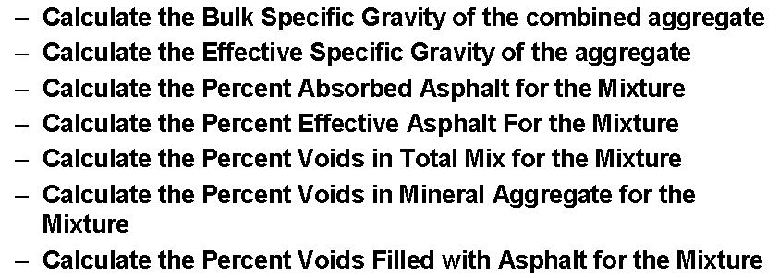
Example 10
Assume that the compacted HMA mixture with the following properties:
Bulk specific gravity of the mixture Bulk Gm = 2.421
Theoretical maximum specific gravity of the mixture max Gm = 2.521
Asphalt binder specific gravity Gs = 1.03
Asphalt binder content Ps = 0.05% by mass of the total mix
Aggregate properties:
Type % of total aggregate Bulk G
A 50% 2.695
B 25% 2.611
C 25% 2.655

Slide 16
Solution
$${Bulk G}_{A}=\frac{100}{\frac{\% A}{G_{sA}}+\frac{\% B}{G_{sB}}+\frac{\% C}{G_{sC}}}$$
$$=\frac{100}{\frac{50}{2.695}+\frac{25}{2.611}+\frac{25}{2.655}}=2.663$$
$$\operatorname{effective}{G_{A}=\frac{100−P_{s}}{\frac{100}{maxG_{m}}−\frac{P_{s}}{G_{s}}}}$$
$${=\frac{100−5}{\frac{100}{2.521}−\frac{5}{1.03}}=2.729}$$
$absorbed asphalt {P"}_{S2}^{}=\left[\frac{1}{{Bulk G}_{A}}−\frac{1}{{eff G}_{A}}\right].G_{s}×100=\left[\frac{1}{2.663}−\frac{1}{2.729}\right]$. 1.0$3×100=0.94\%$
$$effective asphalt P_{S1} =P_{S}−\frac{{P"}_{S2}^{}.P_{A}}{100}=5−\frac{0.94∗95}{100}=4.1\%$$
$\%AV=\left(1−\frac{{Bulk G}_{m}}{{\max{G}}_{m}}\right)×100$
$=\left(1−\frac{2.421}{2.521}\right)×100=4\%$
$\%VMA=100−\frac{{Bulk G}_{m}×P_{A}}{{\operatorname{Bulk}{G}}_{A}}$
$=\left(100−\frac{2.421×95}{2.663}\right)=$13.6%
$\%VFA=\frac{{Bulk G}_{m}×P_{S1}}{{\operatorname{Bulk}{G}}_{m}×P_{S1}+G_{S}×\%AV}×100$
$=\frac{2.421∗4.1}{2.421∗4.1+1.03∗4}×100=70.6 \%$
Or:
$\%VFA=\frac{VMA−AV}{VMA}×100$
$=\frac{13.6−4.0}{13.6}×100=70.6\%$

